Slide 1
IT 206: Object-Oriented Techniques for IT Problem Solving
Arrays of Objects II

Slide 2
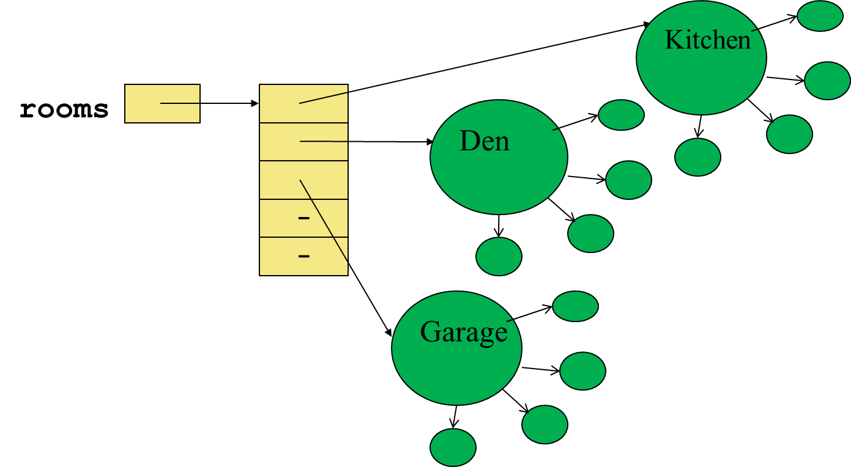
Review: Storing an Object in an Array
After some Rectangle objects are created and stored in an array
The rooms variable holds the address of an array (reference value)
The first 3 elements in the rooms array each hold the address of a Rectangle Object (reference value).

Slide 3
Questions?

Slide 4
Pass By Value: Arrays
To pass an array, Java takes a reference value of the array and creates a new reference value variable inside the method based on the name provided in the method header
Any changes to the array inside the method body will affect the original array that was passed as the argument

Slide 5
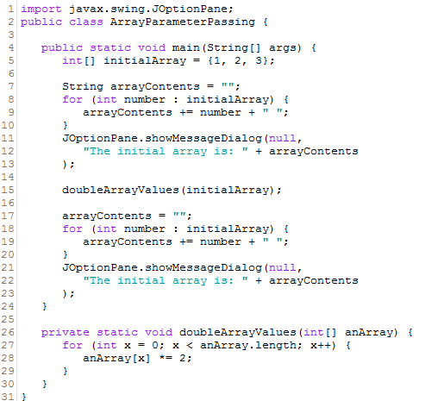
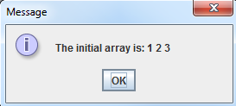
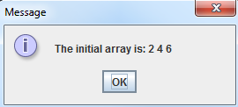
Pass By Value: Arrays (Example)

Slide 6
Passing Objects as Arguments
Similar to arrays, objects can be passed to methods
Java passes all arguments by value
When an object is passed as an argument, the value of the reference variable is passed (called a reference value)
The reference value is an address or reference to the object in memory
A copy of the object is not passed – only a pointer to the object
Any changes to the object within the method are also reflected in the object outside of the method

Slide 7
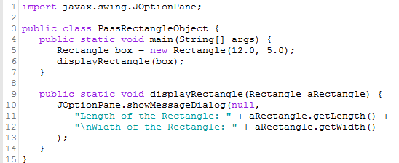
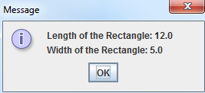
Example: Passing Objects as Arguments
A Rectangle object
length:
width:
displayRectangle(box);
12.0
5.0
Address

Slide 8
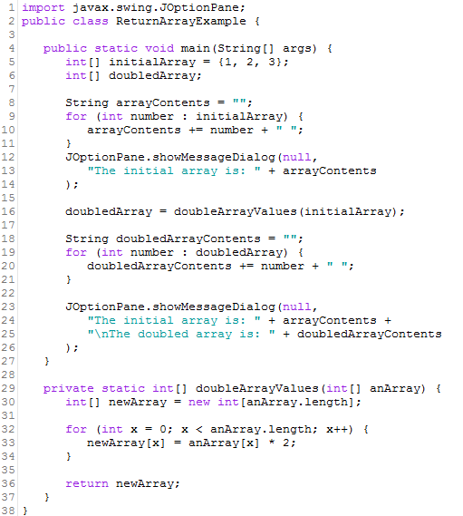
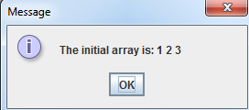
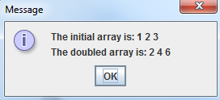
Returning an Array from a Method
Methods can also return complex data types (e.g. arrays)
Use this only when it is important to preserve (use) the original contents of the array; if not, do not return anything (use void)

Slide 9
Returning Objects From Methods
Similar to arrays, objects can also be returned from methods
Methods are not limited to returning primitive data types (e.g. int, double, etc.)
Methods can return references to objects
Just as with passing arguments, a copy of the object is not returned – only the address is returned
balance:
BankAccount account = getAccount();
3200.00
A BankAccount Object
address
public static BankAccount getAccount() {
…
return new BankAccount(balance);
}

Slide 10
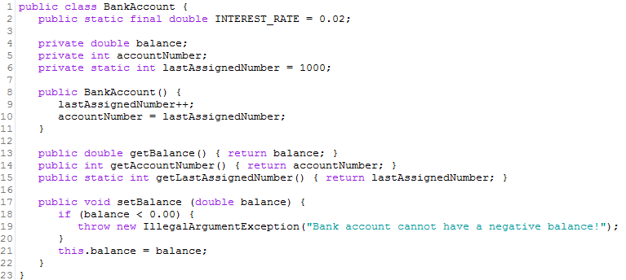
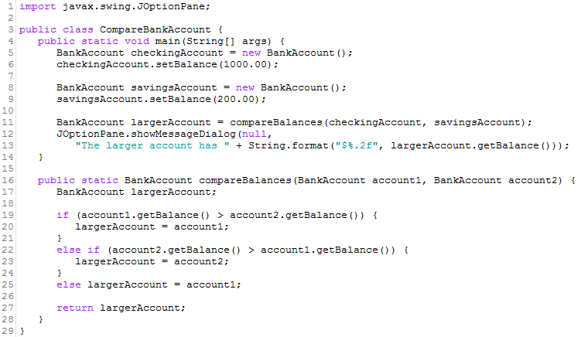
Example: Returning Objects from Methods
Imagine you have two bank accounts (checking and savings). You need a method that will compare which account has the greater balance
CompareBankAccount.java
BankAccount.java

Slide 11
Example: Returning Objects from Methods Object Map

Slide 12
Questions?

Slide 13
Case Study: Simulating a Card Game

Slide 14
Problem Statement
You are working at the GMU eCasino and need to provide a way to simulate one of their card games
In every hand, three cards are picked, one at a time
The player cards are picked first, followed by the dealer cards
The same card can be re-picked (e.g. 3 of Clubs)
The person closest to 30, after picking 3 cards wins
Cards in each deck range from 2 to 10 in suits: Hearts, Diamonds, Clubs, and Spades
Create an object-oriented design and solution to simulate the creation of a player hand and a dealer hand
Print the cards and total of each hand
Print the winner of the hand

Slide 15
OO Approach Step 1: Identify the Object
For each card, there are two pieces of information (attributes/properties) that need to be stored:
Suit
Rank
Across all cards, there are two pieces of information (attributes/properties) that need to be stored
Suit Names
Rank Names
Object: Card
The above identification gives us an idea of what an object might look like

Slide 16
OO Approach Step 2: Identify the Instance/Static Variables
suit
rank
SUITS
RANKS
Inside the left circle: instance variables (attributes/properties that define each card)
Inside the right circle: static variables (attributes/properties that are used by all cards)

Slide 17
OO Approach Step 3: Identify the Instance/Static Methods
Instance
Static
getRank()
getSuit()
toString()
None needed for this problem
ENCAPSULATION
Note: It is already presumed get/set for each variable will be created

Slide 18
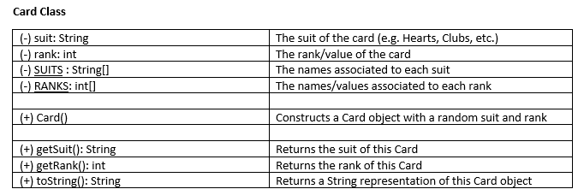
OO Approach From Step 2/3: Create a Detailed UML Class Diagram

Slide 19
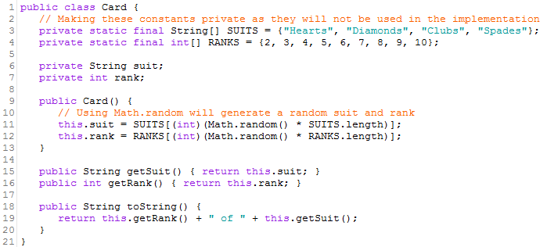
OO Approach Step 4/5: Write Data Definition Class Code

Slide 20
OO Approach Step 6: Design the Implementation
Remember the "Processing" part is covered in the Data Definition class

Slide 21
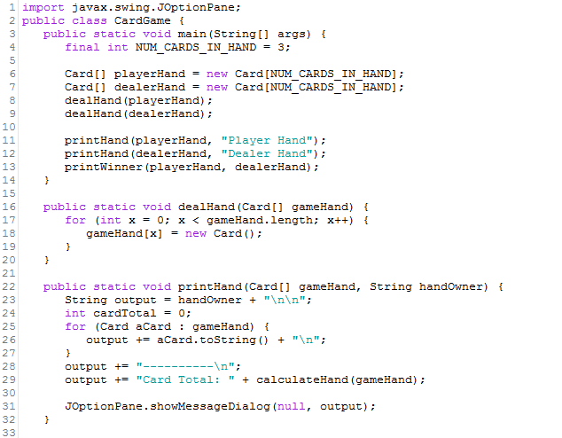
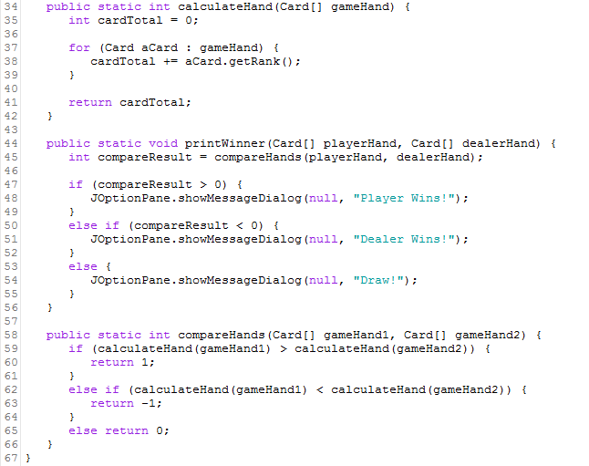
OO Approach Step 7/8: Write/Run/Test Implementation Code
See CardGame.java

Slide 22
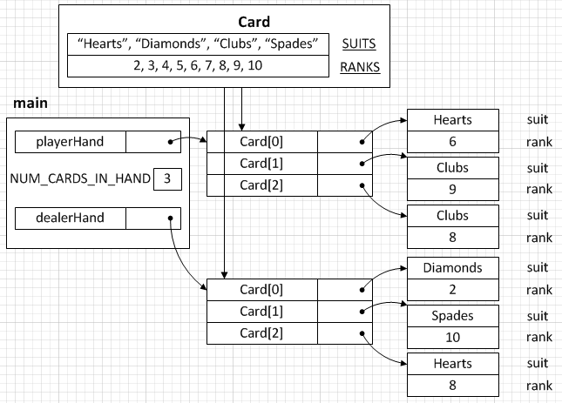
Card Game Object Map

Slide 23
Questions?

